Slide 1
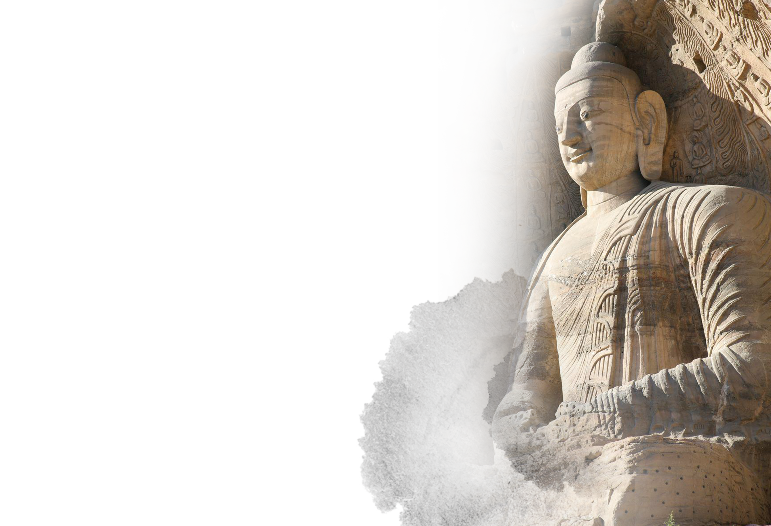
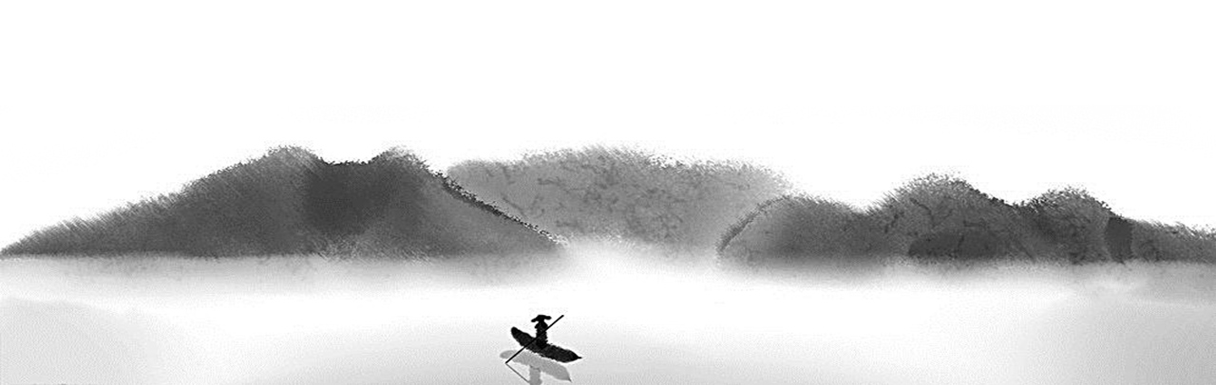
中药在血管神经性头痛方面的临床应用
Clinical Application of Traditional Chinese Medicine in Vascular Neurological Headaches
——中国大同云冈中医师徐宏珍
Traditional Chinese Medicine Practitioner from Yungang, Datong, China - Xu Hongzhen

Slide 2
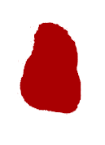
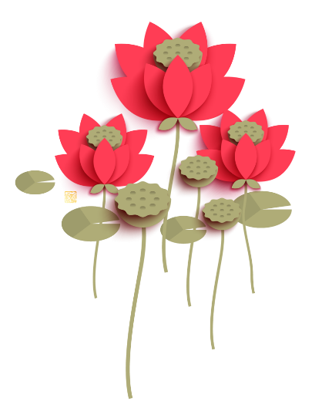
第三章Chapter 3
第二章Chapter 2
第一章
Chapter 1
目录Content
案例简述
Summary of Case(s)
中药在血管神经性头痛方面的临床应用
Clinical Application of Traditional
Chinese Medicine in
Vascular Neurological Headaches
个人简述Personal Profile

Slide 3
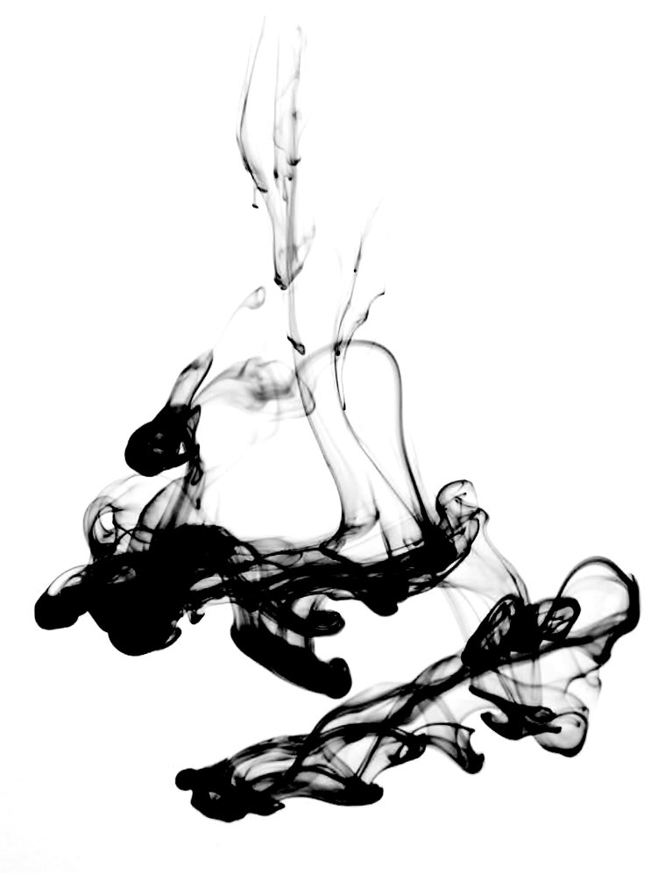
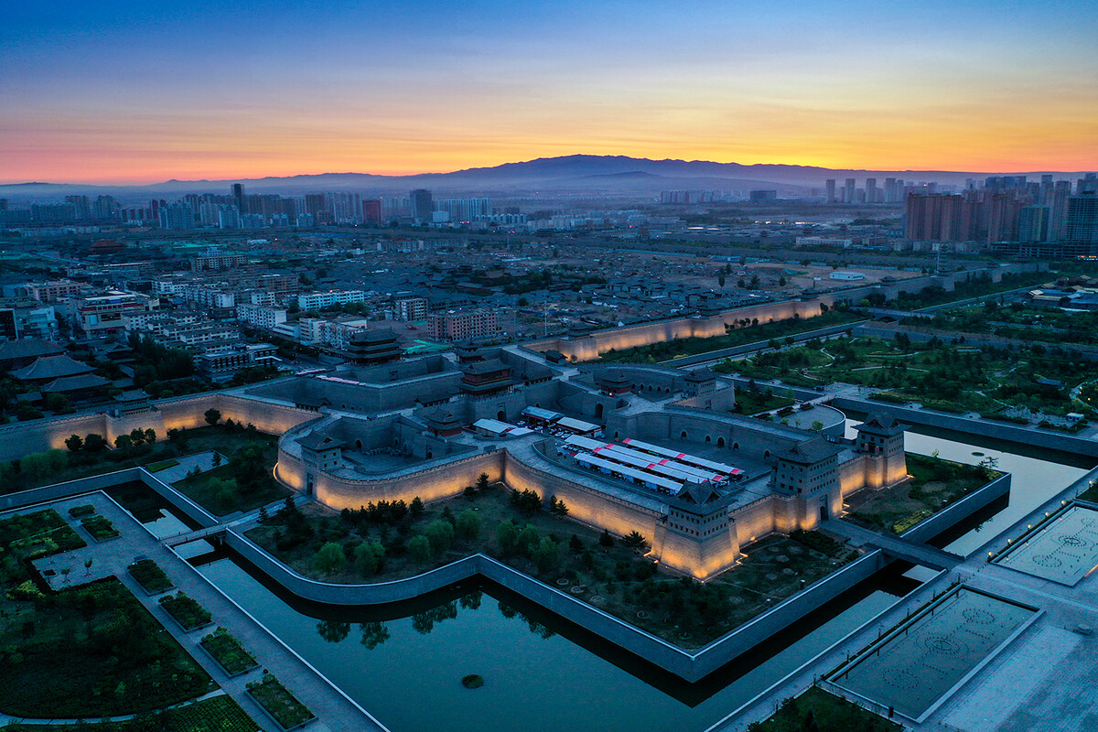
Chapter 1
第一章Chapter 1
个人简述Personal Profile

Slide 4
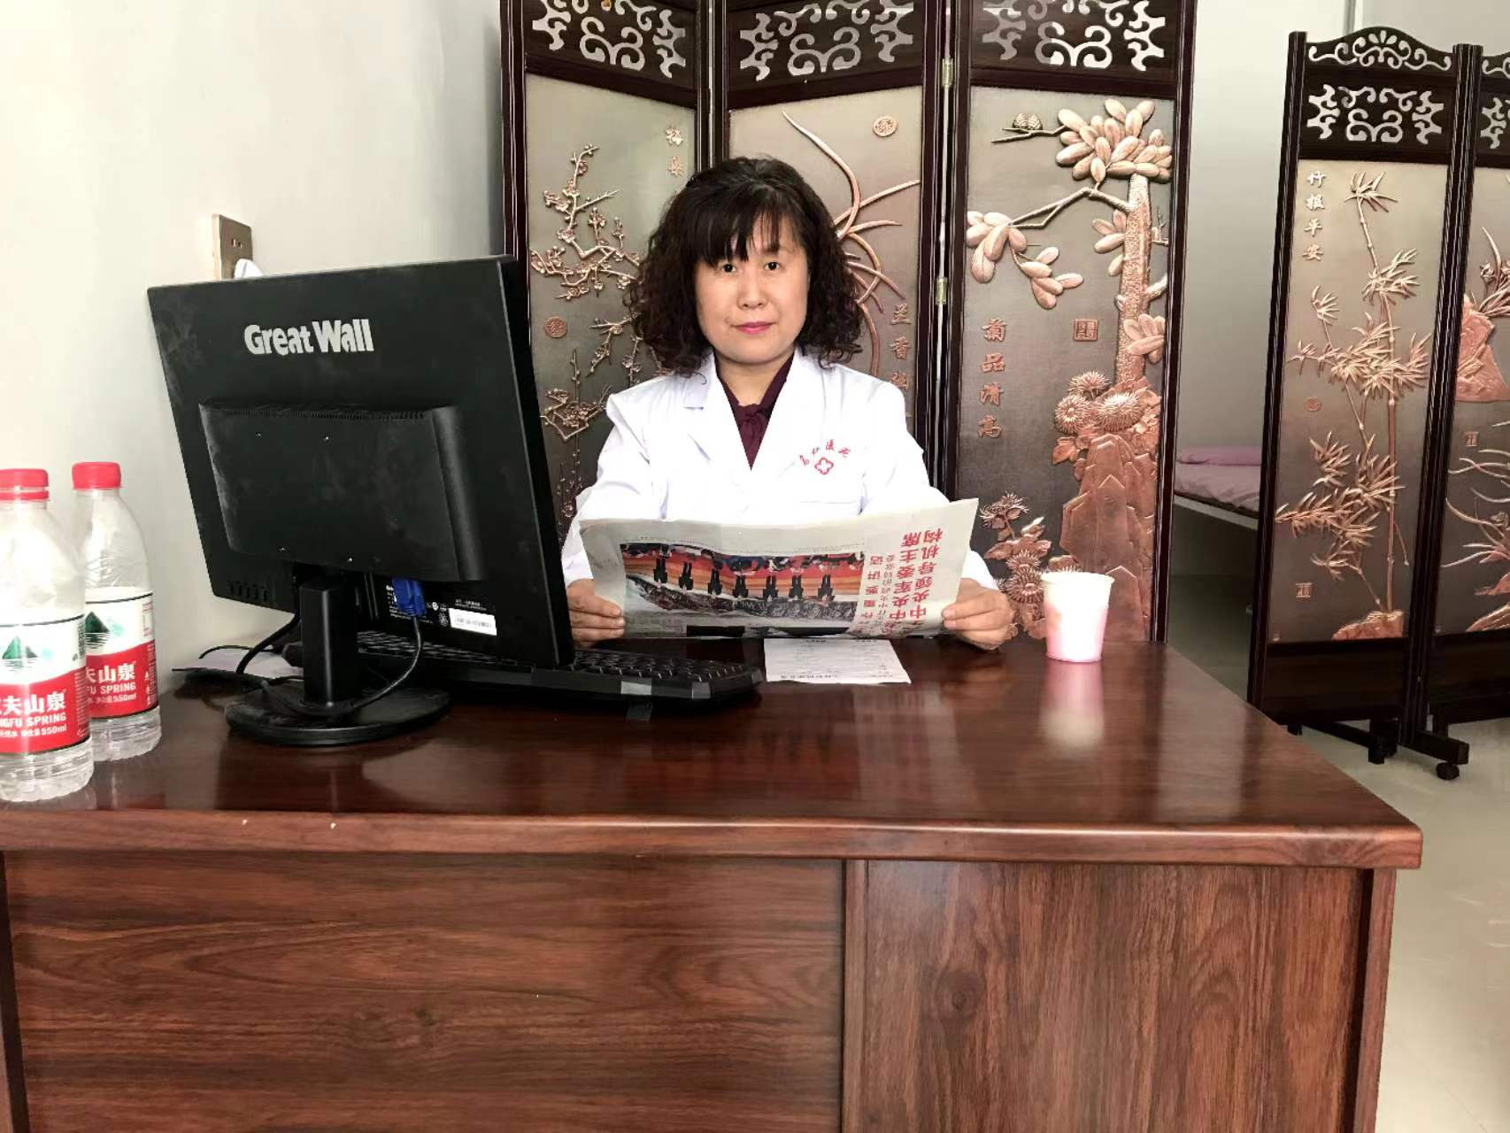
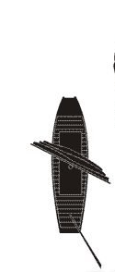
徐宏珍
Xu Hongzhen
中医师，药剂师。
毕业于山西中医药大学，曾在山西医科大学第一附属医院、广西中医药大学二附院、广西壮医医院、北京中医药大学等各地进修学习。
从事临床20余年，专注于肺病研究及内科杂症
Xu Hongzhen: Traditional Chinese Medicine Practitioner and Pharmacist.
Alumnus of Shanxi University of Traditional Chinese Medicine, with comprehensive continuing education at esteemed medical institutions such as Shanxi Medical University First Affiliated Hospital, Second Affiliated Hospital of Guangxi University of Chinese Medicine, Guangxi Zhuang Medicine Hospital, and Beijing University of Chinese Medicine.
Accumulating over two decades of clinical practice, specializing in pulmonary disease research and the treatment of diverse internal medicine conditions.

Slide 5
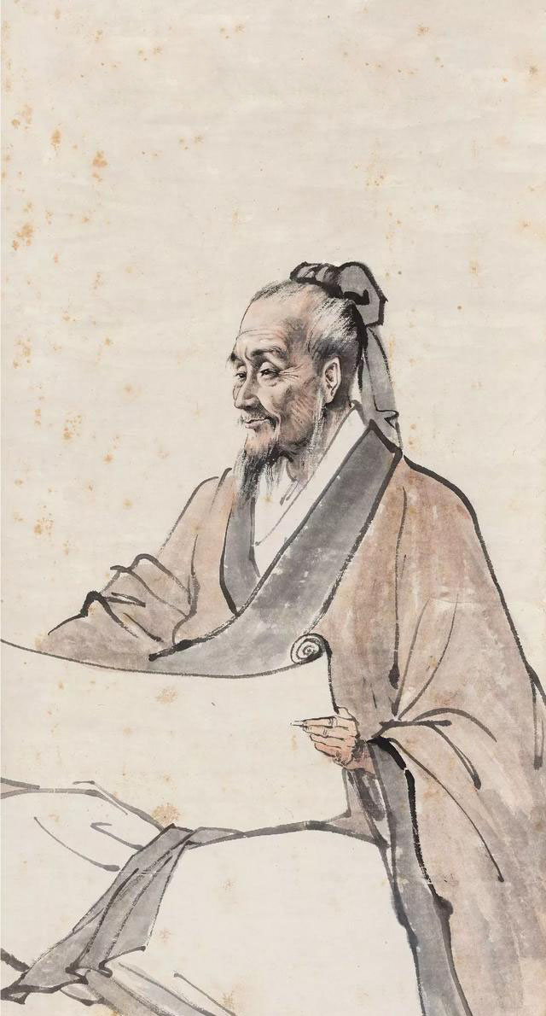
第二章Chapter 2
Chapter 2
中药在血管神经性头痛方面的临床应用
Clinical Application of
Traditional Chinese Medicine
in Vascular Neurological Headaches

Slide 6
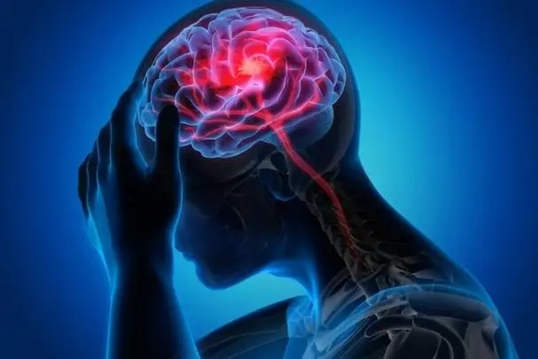
血管神经性头痛是一种以头部血管舒缩功能障碍及大脑皮层失调为主要特点的综合症
Vascular Neurological Headache is characterized by a complex syndrome primarily associated with dysfunction in the vasomotor regulation of cranial blood vessels and cortical dysregulation in the brain

Slide 7
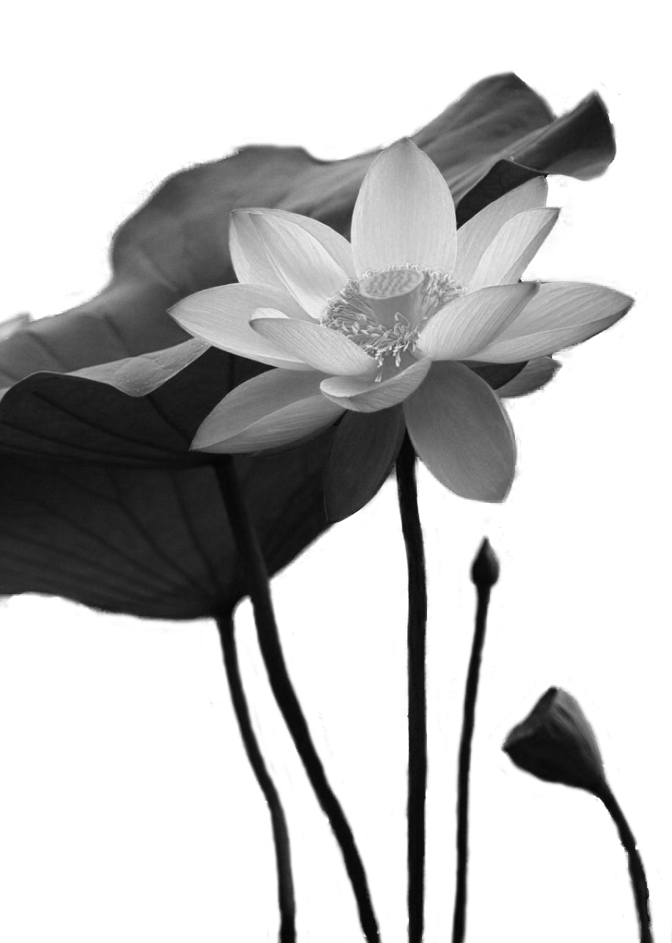
头为诸阳之会，脑为清灵之府，五脏六腑精气，皆上注于此，故外感、内外诸种因素瘀阻脑络与清窍，清阳不达，浊阴翳蔽，因而痛作。
The head is the confluence of all yang energies, while the brain is the residence of clarity and spirituality. The essence and vitality of the five viscera and six bowels ascend to this place, hence, when external pathogens or various factors obstruct the cerebral vessels and the clarity apertures internally and externally, preventing the ascent of clear yang and obscuring the turbid yin, pain ensues.

Slide 8
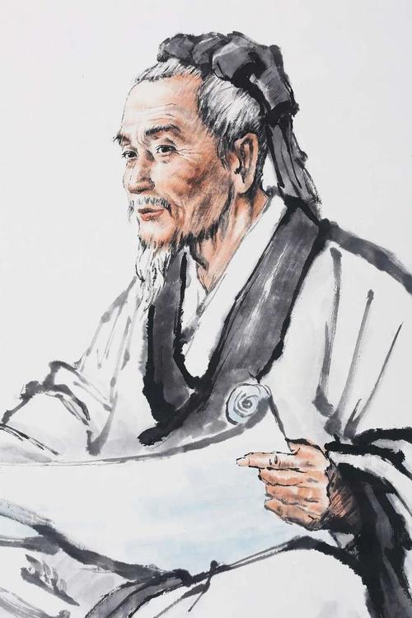
《素问. 五脏生成篇》还提出“是以头痛巅疾，下虚上实”
In the chapter 'Formation of the Five Zang Organs' of the Yellow Emperor's Inner Classic, it is also stated, 'Hence, headaches are characterized by excess above and deficiency below.

Slide 9
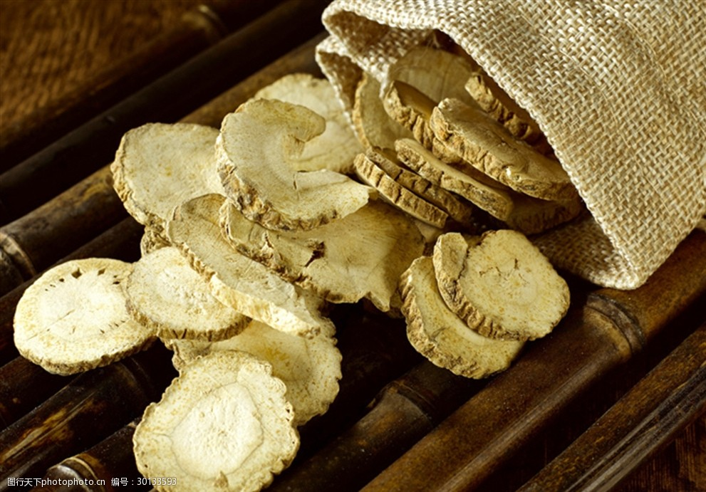
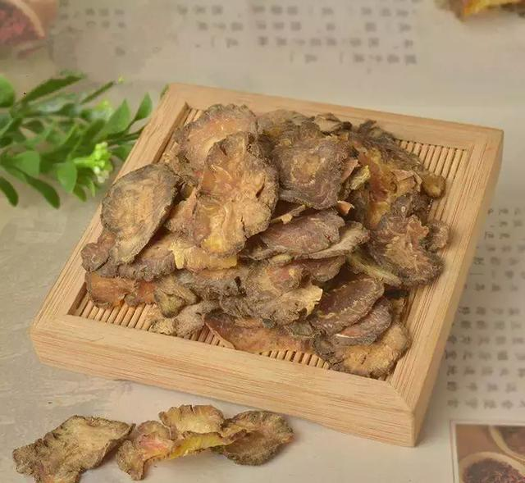
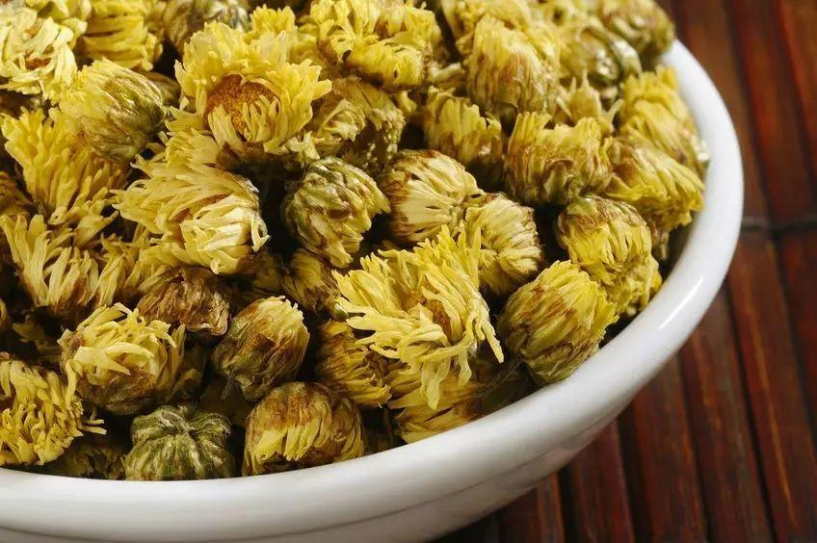
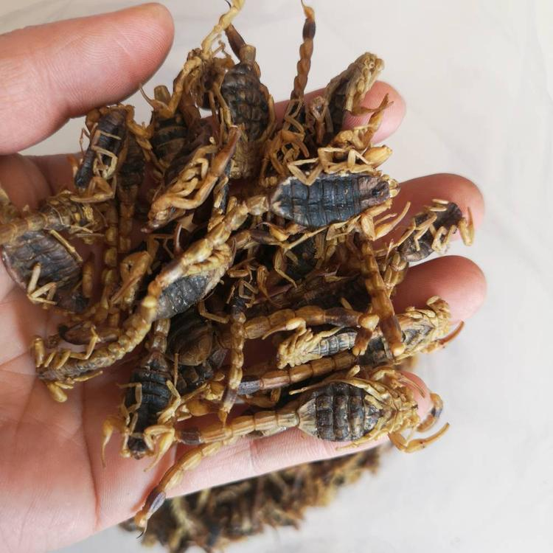
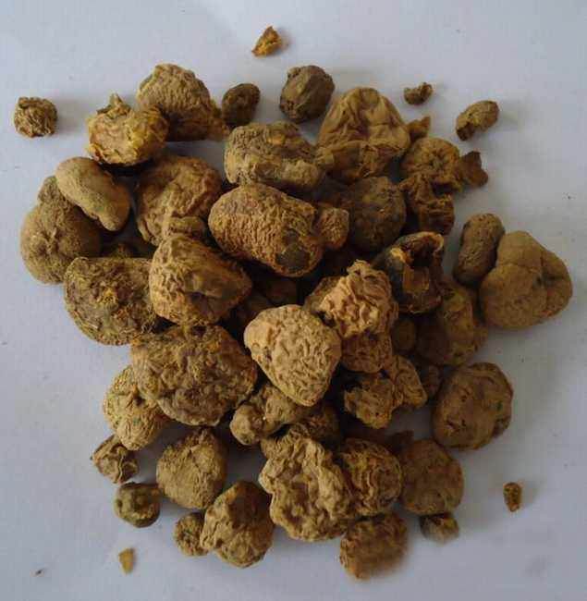
治疗以祛风止痛，活血行瘀为主
The treatment primarily focuses on dispelling wind, alleviating pain, promoting blood circulation, and removing blood stasis

Slide 10
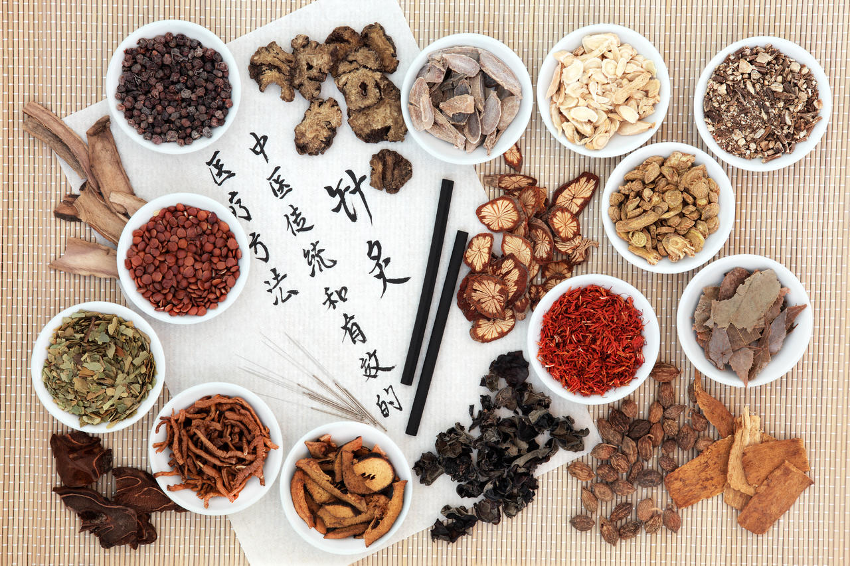
Chapter 3
第三章Chapter 3
案例简述
Summary of Case(s)

Slide 11

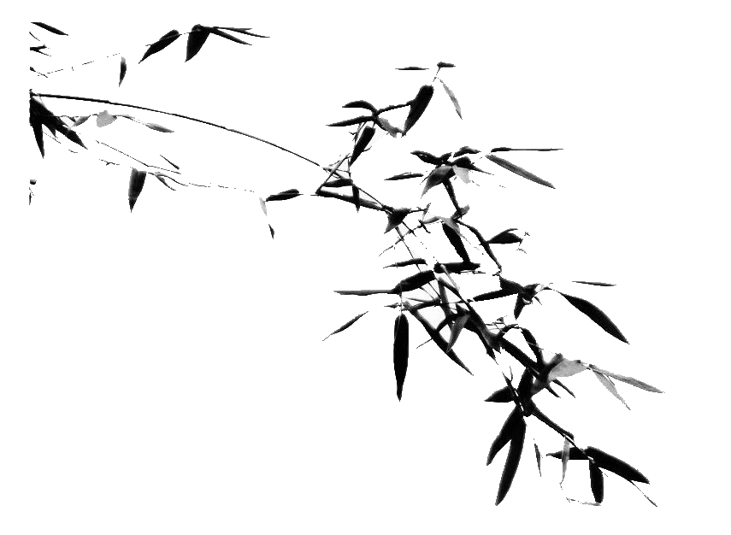
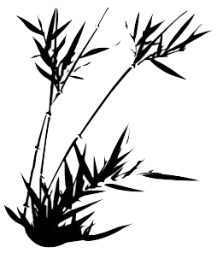
案例1
Case I
患者姓名：杨xx，男，21岁，2006年，4月5日诊，头痛剧烈，如刀剜，遇风尤剧，伴恶心，口不渴，苔薄白，脉浮，服布洛芬、正天丸等效果不好，神经系统包括眼底检查未见异常，脑超声波、脑电图排除占位性病变，脑电图报告脑血流量减少。
Patient Name: Yang XX
Gender: Male
Age: 21
Date of Diagnosis: April 5, 2006
Chief Complaint: The patient presents with severe headache described as stabbing, worsened by wind, accompanied by nausea. However, there is no sensation of thirst. Additionally, the patient exhibits a thin white tongue coating and a floating pulse.
Medical History: Ineffective response to medication including ibuprofen and Zhengtian Pills.
Neurological Examination: No abnormalities observed in the neurological and fundoscopic examinations.
Imaging and Tests: Brain ultrasound and electroencephalogram ruled out space-occupying lesions. EEG report indicates reduced cerebral blood flow.
处方：
治疗：疏风止痛。
处方：川芎10克，荊芥10，防风10克，羌活10克，白芷10克，细辛3克，全蝎4克，白芍10克，丹参10克，葛根10克，木瓜10克，元胡15克，当归10克，甘草10克，5付，水煎服日一付。
一周后复诊，症状减轻，上方继续，巩固疗效
Prescription:
Treatment: Dispel Wind and Alleviate Pain.
Ingredients:
Chuanxiong 10g,Jingjie 10g,Fangfeng 10g,Qianghuo 10g,Baizhi 10g,Xixin 3g,Quanxie 4g,Baishao 10g,Danshen 10g,Gegen 10g,Mugua 10g,Yuanhu 15g,Danggui 10g,Gancao 10g.
5 doses. Decoct with water and take orally once daily.
Follow-up after one week: Symptoms have alleviated. Continue with the above prescription to consolidate the therapeutic effect

Slide 12
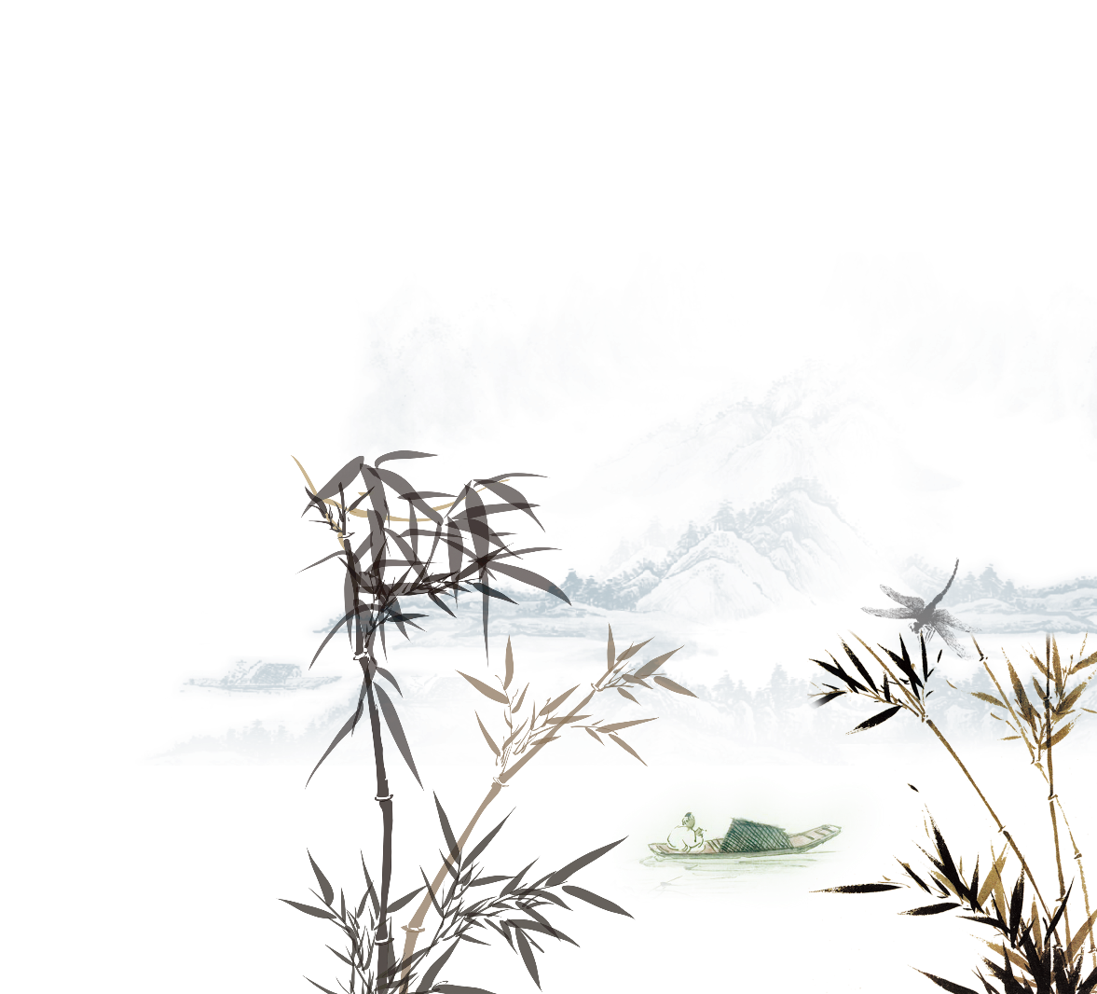
案例2 Case II
患者姓名：张xx，男，64岁，2024年1月15日诊。头痛剧烈，痛如锥刺，游走不定，痛时局部血管青筋怒张，半年，发作2次，入夜尤甚，心烦口苦，面红易怒，血压140／85，苔薄黄，脉弦有力。
Patient Name: Zhang XX, Age: 64, Date of Diagnosis: January 15, 2024
Chief Complaint: Severe headache described as stabbing, with wandering pain. Local blood vessels appear congested during episodes. Occurs twice in the past six months, with exacerbation at night. Accompanied by irritability, bitter taste in the mouth, and flushed complexion. Blood pressure is 140/85 mmHg. Thin yellow tongue coating. Pulse is wiry and forceful.
治疗：治肝泻火。祛风止痛。
处方：天麻10克，钩藤10克，决明子10克，黄芩10克， 栀子10克，牛膝10克，杜仲10克，生地10克， 女贞子10克，全蝎4克，当归10克，牡蛎1O克， 白芍10克，地龙10克，炙甘草10克。5付，水煎服，配局放血。
5天后痊愈，又服15付巩固疗放。
Treatment: Soothe Liver and Clear Fire. Expel Wind and Alleviate Pain.
Prescription:
Tianma 10g,Gouteng 10g,Juemingzi 10g,Huangqin 10g,Zhizi 10g,Niuxi 10g,Duzhong 10g,Shengdi 10g,Nvzhenzi 10g,Quanxie 4g,Danggui 10g,Muli 10g,Baishao 10g,Dilong 10g,Zhi Gancao 10g.
5 doses. Decoct with water and take orally. Apply blood-letting therapy concurrently.
Recovered after 5 days. Continued with 15 doses for consolidation therapy.

Slide 13
案例3 Case III
患者姓名：李xx，女，52岁，2017年6月3日，头痛而晕，遇劳加重，神疲乏力，面色晄白，舌质淡，脉细弱。
Patient Name: Li XX Gender: Female
Age: 52 Date of Diagnosis: June 3, 2017
Chief Complaint: Headache accompanied by dizziness, exacerbated by exertion. Fatigue and weakness. Pale complexion. Pale tongue with a thin coating. Pulse is weak and thready
治疗：养血祛风。
处方：当归15克，白芍10克，生地10克，川芎1O，菊花10克，蔓荊子10克，黄芪15克，党参10克， 枸杞10克，杜仲10克，元胡10克，甘草10克。
服二十 剂，愈，多年未复发。
Treatment: Nourish Blood and Expel Wind.
Prescription:
Danggui 15g,Baishao 10g,Shengdi 10g,Chuanxiong 10g,Juhua 10g,Manjingzi 10g,Huangqi 15g,Dangshen 10g,Gouqizi 10g,Duzhong 10g,Yuanhu 10g,Gancao 10g.
Administered for 20 doses. Patient recovered thereafter and has not experienced a relapse for many years.

Slide 14
谢谢大家聆听
Thank you all for listening

